Slide 1
AMST 140 Washington: Life inside a Monument
Week 12: Gentrification & Culture -
A Deeper Dive

Slide 2
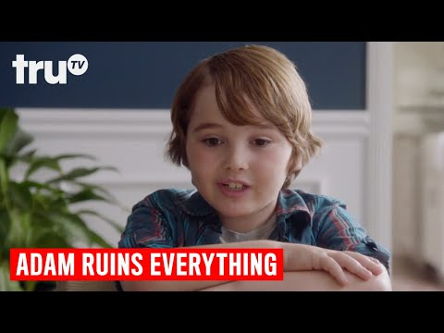
On Gentrification - A Primer for today
In your notes record the following:
How did “redlining” result in compounding positive benefits to white families in America?
How did it do the opposite for people of color?
What are the lasting effects?

Slide 3
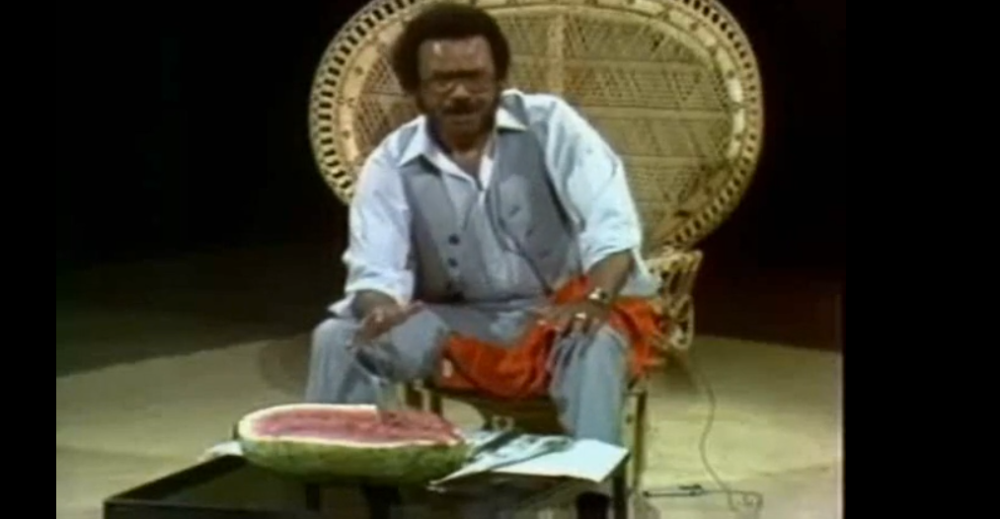
“Old” DC: Explore the Culture via Petey Greene
Petey Greene said and featured highly controversial and even offensive things.
Why do you think he was a beloved community leader for speaking as he did?
Click the here to play the video: https://vimeo.com/6927484

Slide 4
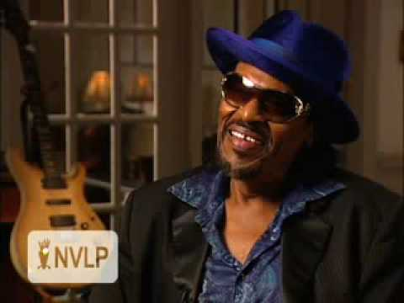
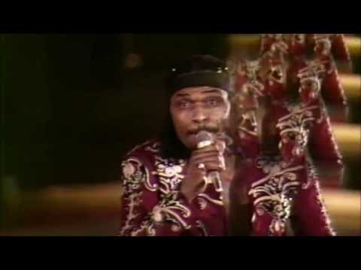
“Old” DC: A Homegrown Music - Go-Go

Slide 5
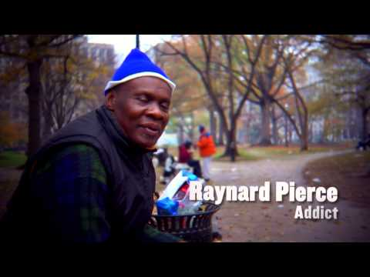
“Old” DC: Graffiti Culture

Slide 6
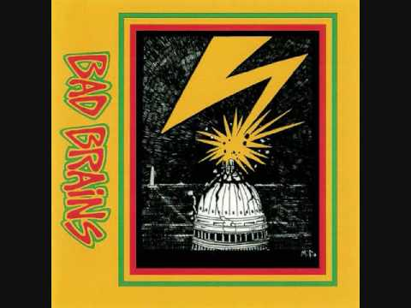
“Old” DC: A Rad Underground Punk Scene

Slide 7
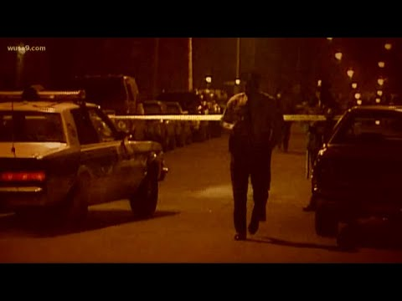
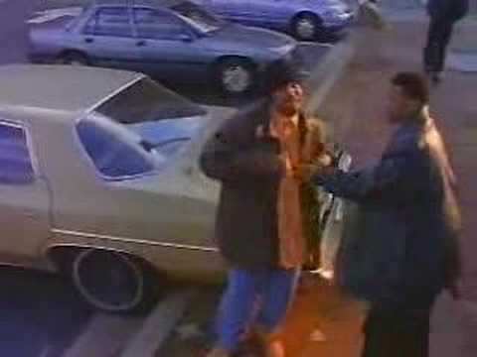
“Old” DC: An Infamous Nickname: “Murder Capital”
Considering what you’ve learned about DC in the 1980s and 1990s, why do you think that the illegal drug economy and drug use was so enticing to black youth in the city?

Slide 8
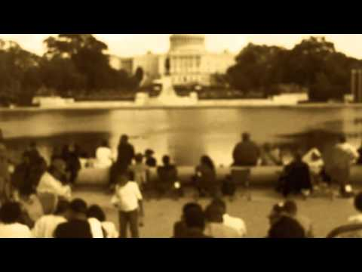
DC Residents Reminisce: In words and music
How do these 2 Hip Hop artists, born and raised in DC talk about:
Their hometown
DC culture and arts
Their experience/view on gentrification

Slide 9
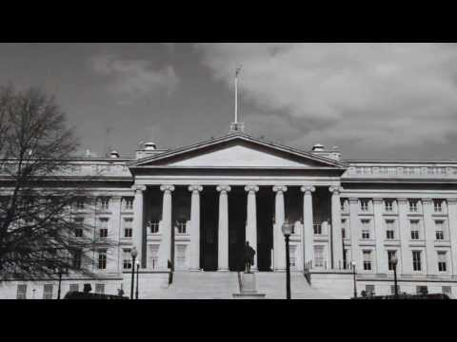
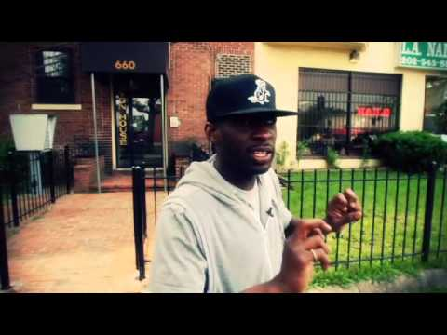
Listen More: Uptown XO

Slide 10
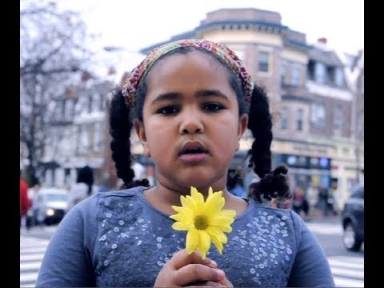
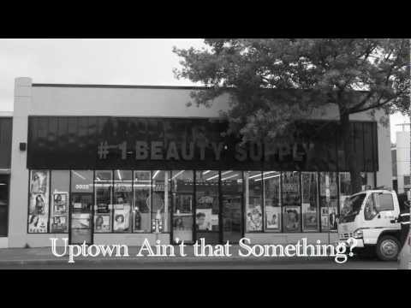
Listen More: HeadRoc on “New” DC

Slide 11
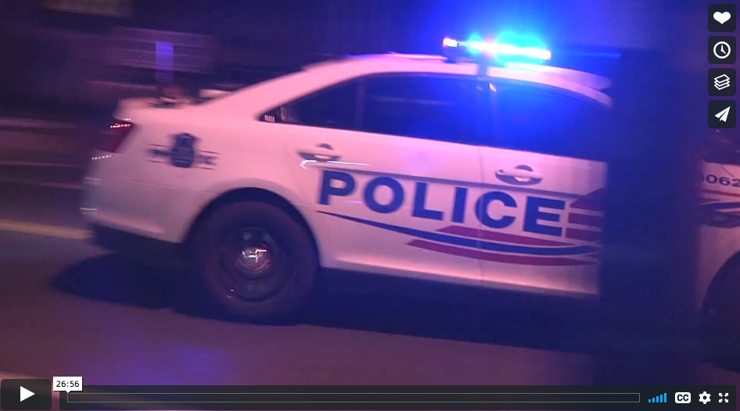
Policing Gentrification in Washington, DC
For your notes:
What critique of police is discussed in this film?
What is your view of this critique?
Click the link to play: https://vimeo.com/josephmarcus/policing-gentrification

Slide 12
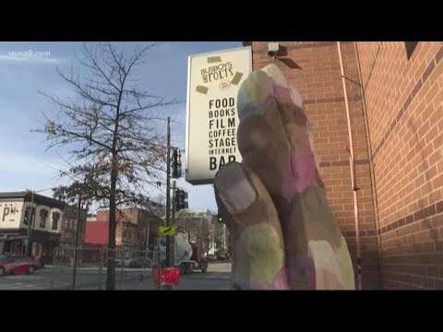
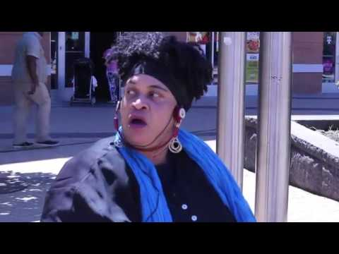
“New” DC community members sound off

Slide 13
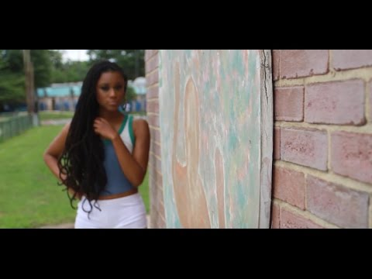
“New” DC - Tarica June - “But Anyway”

Slide 14
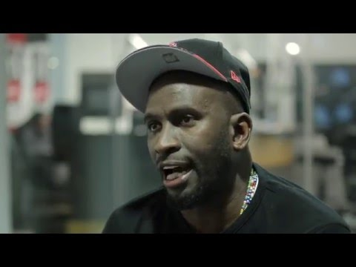
“New” DC Homegrown Music and Gentrification

Slide 15
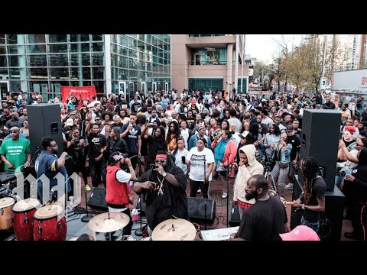
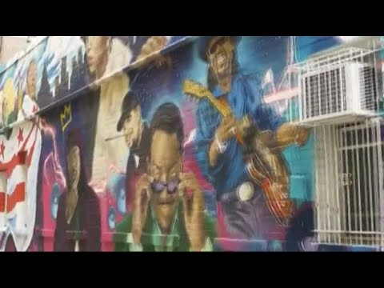
A Final Word: Don’t Mute DC

